Slide 1
COASTAL RESILIENCE TOOLKIT (CRT)’ STEPS
Langkah 1
Penilaian Risiko
(Risk Assessment)
26 sub tools
3 sub tools
11 sub tools
Langkah 4
Pengukuran Efektivitas
(Effectiveness Measurement)
42
sub tools
Langkah 2
Identifikasi Solusi
(Solution Identification)
2 sub tools
Langkah 3
Penilaian Tata-kelola Resiliensi dan Investasi PRB
(Assessment of Governance Resilience and its Impact on DRR Investment)

Slide 2
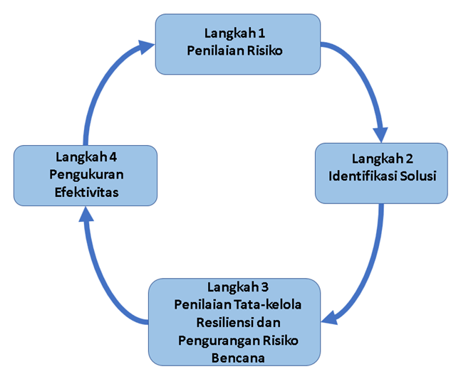
COASTAL RESILIENCE TOOLKIT (CRT)’S PRECEDENTS
Penilaian Kerusakan Pantai,
PUPR
Pengembangan Desa Pesisir Tangguh (PDPT) , KKP
Desa Tangguh Bencana ,
BNPB
Ina-SAFE (Indonesia Scenario Assessment for Emergency),
World Bank, BNPB, AIFDR,
26 sub tools
Coastal Climate Adaptation Decision Support (C-CADS),
Australian Government/DoEE
3 sub tools
11 sub tools
42
sub tools
Program Kampung Iklim,
KLHK
SDGs Desa,
Kemendes PDTT
2 sub tools
Coastal Resilience Toolkit (CRT) Draft,
BNPB, SIAP SIAGA
2010
2012 - 2016
2017
2021
2023
2024

Slide 3
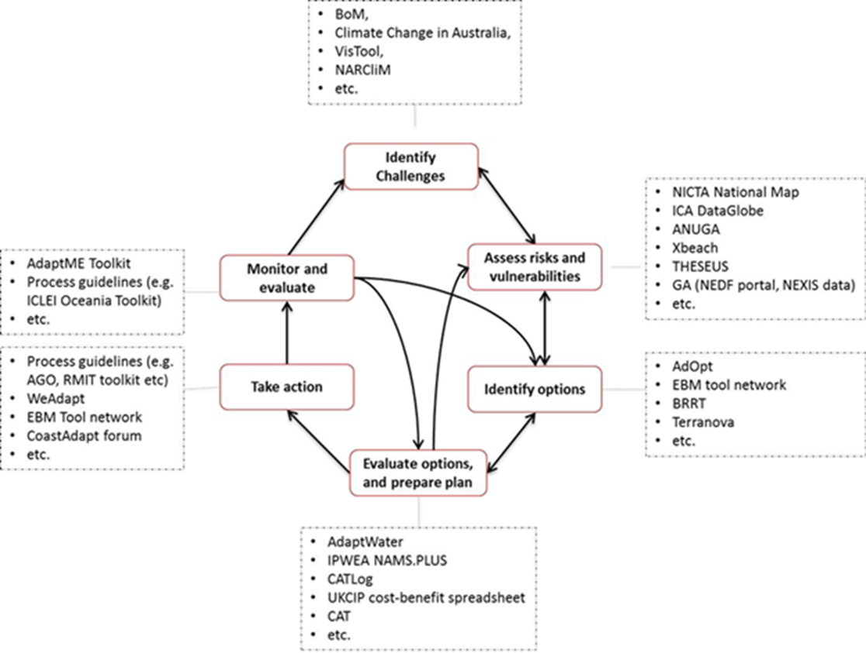
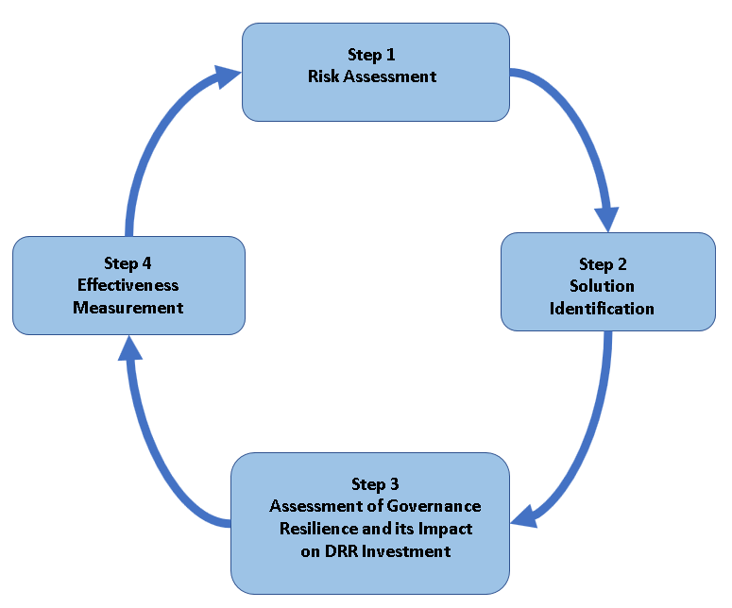

COASTAL RESILIENCE TOOLKIT (CRT)’S DUAL FUNCTIONS
DOMESTIC
(REPUBLIC OF INDONESIA)
PACIFIC ISLAND COUNTRIES
26 sub tools
26 sub tools
3 sub tools
11 sub tools
3 sub tools
11 sub tools
42
sub tools
2 sub tools
2 sub tools

Slide 4
COASTAL RESILIENCE TOOLKIT (CRT)’ SUB TOOLS
1.1. Bahaya dan tipe kerusakan pantai (Hazard and coastal damage types)
Langkah 1
Penilaian Risiko
26 sub tools
1.2. Proyeksi bahaya pesisir (Coastal hazard projections)
1.3. Indeks Kerentanan (Vulnerability Indexes)
Langkah 4
Pengukuran Efektivitas
Langkah 2
Identifikasi Solusi
1.4 Indeks Kapasitas (Capacity Index)
1.5 Indeks Risiko (Risk Index)
Langkah 3
Penilaian Tata-kelola Resiliensi dan Investtasi PRB
Method = 100%
QGIS Manual = 11%
QGIS GF = 0,7%
QGIS Plugin = 0%

Slide 5
2.1. Akses Basis-data Solusi (Access the table of alternative solutions ).
Langkah 1
Penilaian Risiko
2.2. Akses Pedoman Implementai (Select the Guidelines/ Technical document for implementation)
11 sub tools
Langkah 4
Pengukuran Efektivitas
Langkah 2
Identifikasi Solusi
2.3. Basis-data implementasi kategori baik (Best practice for implementation)
2.4. Model Analisis Resiliensi Berkelanjutan (Sustainable Resilience Analytical Model)
Langkah 3
Penilaian Tata-kelola Resiliensi dan Investtasi PRB
2.5 Rencana Aksi (Action Plan)
Method = 45%
QGIS Manual = 0%
QGIS GF = 0%
QGIS Plugin = 0%

Slide 6
Langkah 1
Penilaian Risiko
3.1 Tata-kelola Pemerintahan berorientasi Resiliensi (Resilience Governance)
Langkah 4
Pengukuran Efektivitas
Langkah 2
Identifikasi Solusi
3.2 Investasi Pengurangan Risiko Bencana (Impact on DRR Investment)
2 sub tools
Langkah 3
Penilaian Tata-kelola Resiliensi dan Investtasi PRB
Method = 50 %
QGIS Manual = 0%
QGIS GF = 0%
QGIS Plugin = 0%

Slide 7
Langkah 1
Penilaian Risiko
3 sub tools
4.1 Laporan Program (Program completion report).
Langkah 4
Pengukuran Efektivitas
Langkah 2
Identifikasi Solusi
4.2 Reduksi Kerentanan (Vulnerability Reduction)
4.3 Kalkulasi Efektivitas (Effectiveness calculation)
Langkah 3
Penilaian Tata-kelola Resiliensi dan Pengurangan Risiko-Bencana
Method = 67%
QGIS Manual = 33%
QGIS GF = 0%
QGIS Plugin = 0%

Slide 9


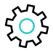
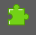

Langkah 1 - Penilaian Risiko
(Risk Assessment)
QGIS Graphical Modeller
manual
tutorial
Plugin
Case study
1.1. Bahaya dan tipe kerusakan pantai (Hazard and coastal damage types)
1.2. Proyeksi bahaya pesisir (Coastal hazard projections)
1.3. Indeks Kerentanan (Vulnerability Indexes)
1.4 Indeks Kapasitas (Capacity Index)
1.5 Indeks Risiko (Risk Index)

Slide 10
Langkah 2 - Identifikasi Solusi
(Solution Identification)
QGIS Graphical Modeller
manual
tutorial
Plugin
Case study
2.1. Akses Basis-data Solusi (Access the table of alternative solutions ).
2.2. Akses Pedoman Implementai (Select the Guidelines/ Technical document for implementation)
2.3. Basis-data implementasi kategori baik (Best practice for implementation)
2.4. Model Analisis Resiliensi Berkelanjutan (Sustainable Resilience Analytical Model)
2.5. Rencana Aksi (Action plan)

Slide 11
Langkah 3 - Penilaian Tata-kelola Resiliensi dan Investasi PRB
(Assessment of Governance Resilience and its Impact on DRR Investment)
3.1 Tata-kelola Pemerintahan berorientasi Resiliensi (Resilience Governance)
3.2 Investasi Pengurangan Risiko Bencana (Impact on DRR Investment)

Slide 12
Langkah 4 - Pengukuran Efektivitas
(Effectiveness Measurement)
4.1 Laporan Program (Program completion report).
4.2 Reduksi Kerentanan (Vulnerability Reduction)
4.3 Kalkulasi Efektivitas (Effectiveness calculation)

